Slide 1
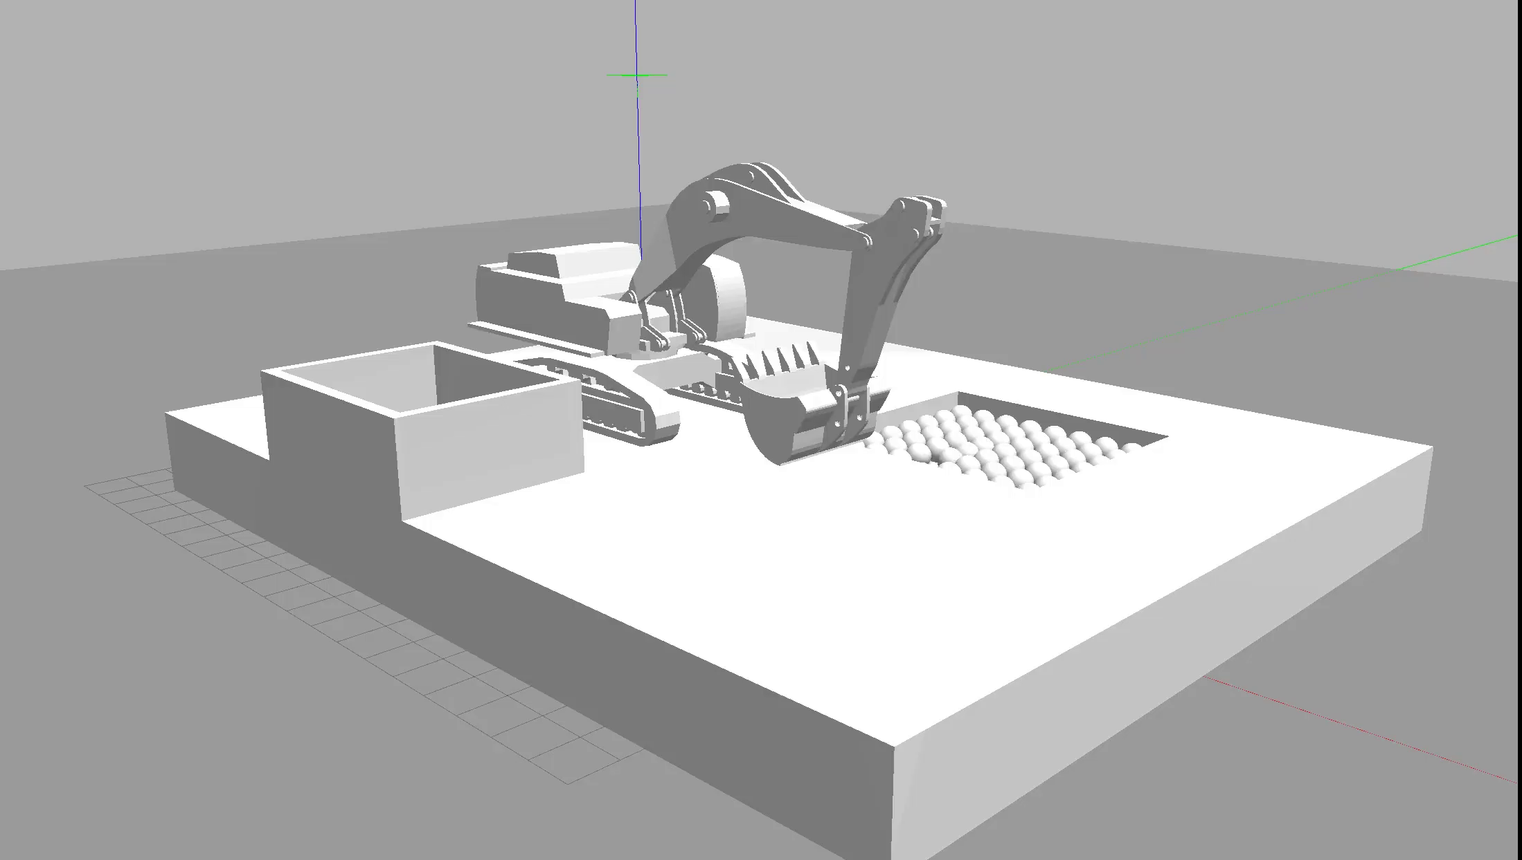
Display speed X2
The simulation is executed on a 4-core CPU and achieves convergence within 300k samples.
Notes:
At first, I may have a brief introduction of the motivation of the thesis.
THE automation of heavy hydraulic equipment, in particular excavators has various benefits such as safety, increased productivity and decreased costs.
Here’s a sketch of the autonomous excavator system, namely AES.
The excavator receives environmental input through its sensors, which it utilizes to analyze and plan the digging motion. Based on the perception data, it generates appropriate actions and subsequently translates them into specific movements using pedals and levers, effectively executing the digging motion.
Our thesis focus on the planning of the digging motion.

